Slide 1
At Least Once
Life without Two-Phase Commit
@ICooper

Slide 2
Who are you?
Software Developer for more than 25 years
Stuff I care about: Messaging, EDA, Microservices, TDD, XP, OO, RDD & DDD, Code that Fits in My Head, C#
Places I have worked: DTI, Reuters, Sungard, Beazley, Huddle, Just Eat Takeaway
No smart folks
Just the folks in this room

Slide 3
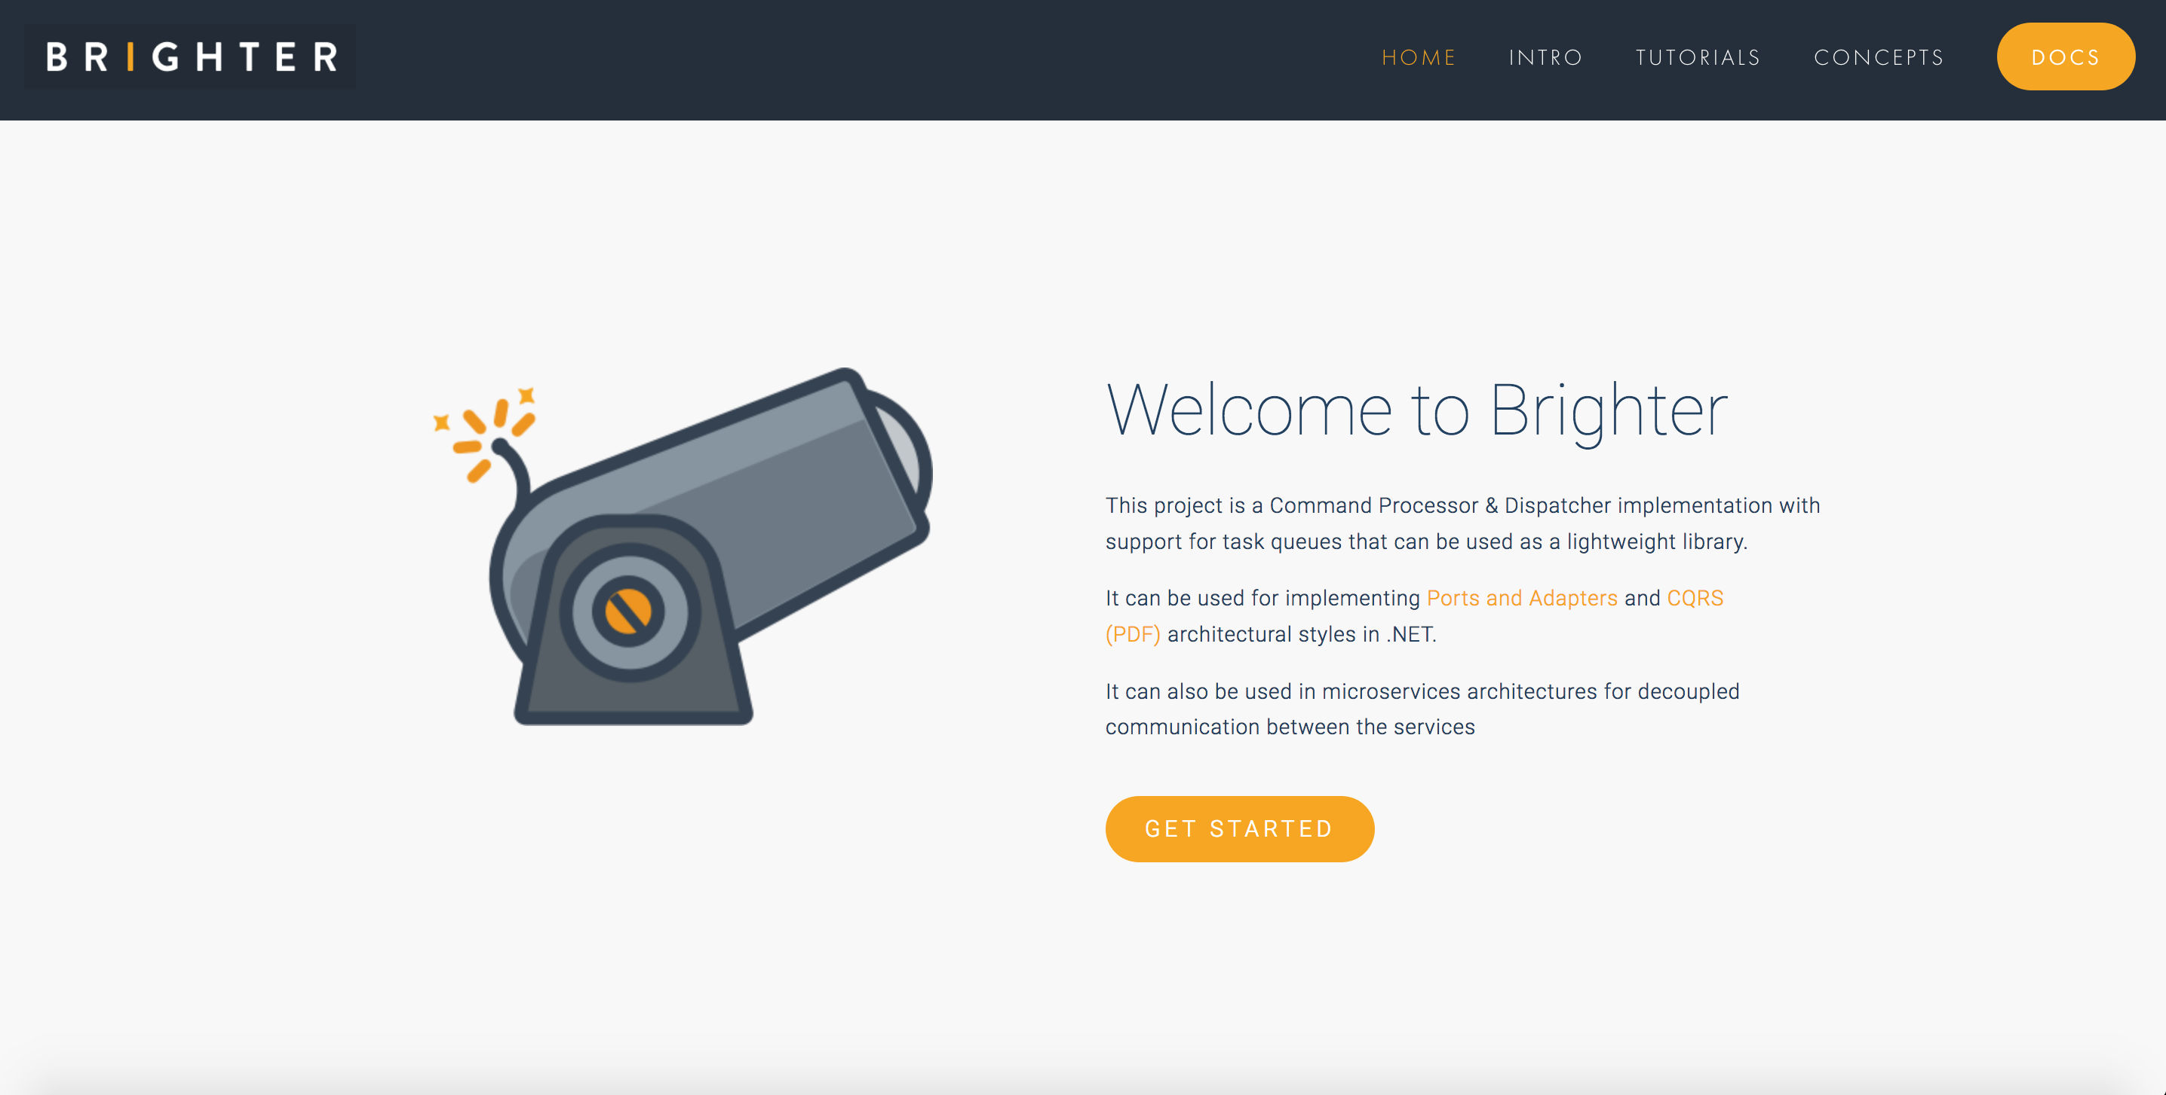

Slide 4
Agenda
Fiefdoms: Autonomous Components
Collaborations: Work Across Fiefdoms
Future and Past: If Not Now, When?
Emissaries: Interacting with Fiefdoms
Messaging: Conversations Between Fiefdoms, Outbox and Inbox
Data: Resources, Activities, Reference, Requests
Brighter Example

Slide 5
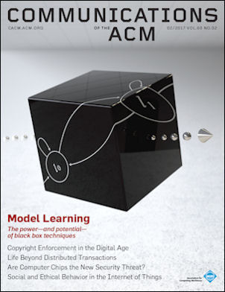
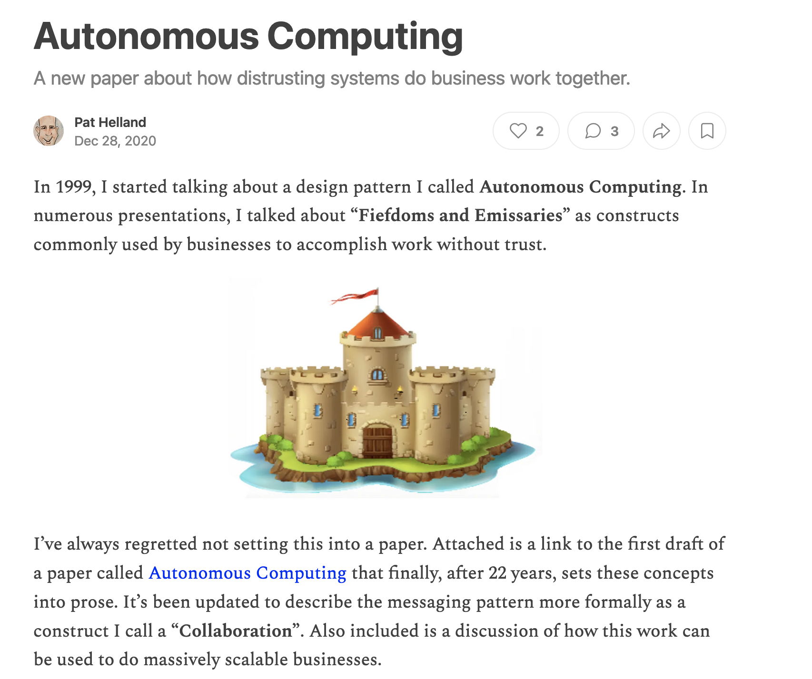
Life Beyond Distributed Transactions
Autonomous Computing
Pat Helland 2007
Notes:
In general, application developers simply do not implement large scalable applications assuming distributed transactions.
We discuss the management of fine-grained pieces of application data which may be repartitioned over time as the application grows.
We also discuss the design patterns used in sending messages between these repartitionable pieces of data.

Slide 6
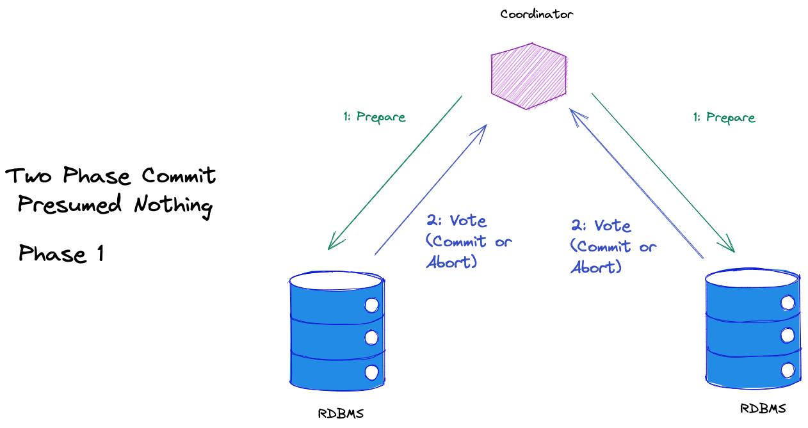
Notes:
In order to create a transaction that spans two scopes – two RDBMs in this instance – we need to use a distributed transaction via 2PC
Prepare – can you commit this
All vote to commit or abort

Slide 7
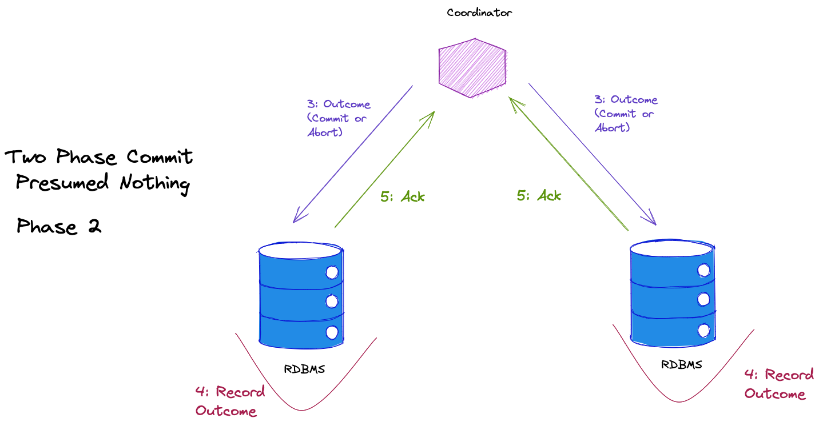
Notes:
Coordinator publishes outcome: commit it, or abort it
Scope records outcome and acks back to say it is done

Slide 8
Agenda
T:10
Fiefdoms: Autonomous Components
Collaborations: Work Across Fiefdoms
Future and Past: If Not Now, When?
Emissaries: Interacting with Fiefdoms
Messaging: Conversations Between Fiefdoms, Outbox and Inbox
Data: Resources, Activities, Reference, Requests
Brighter Example

Slide 9
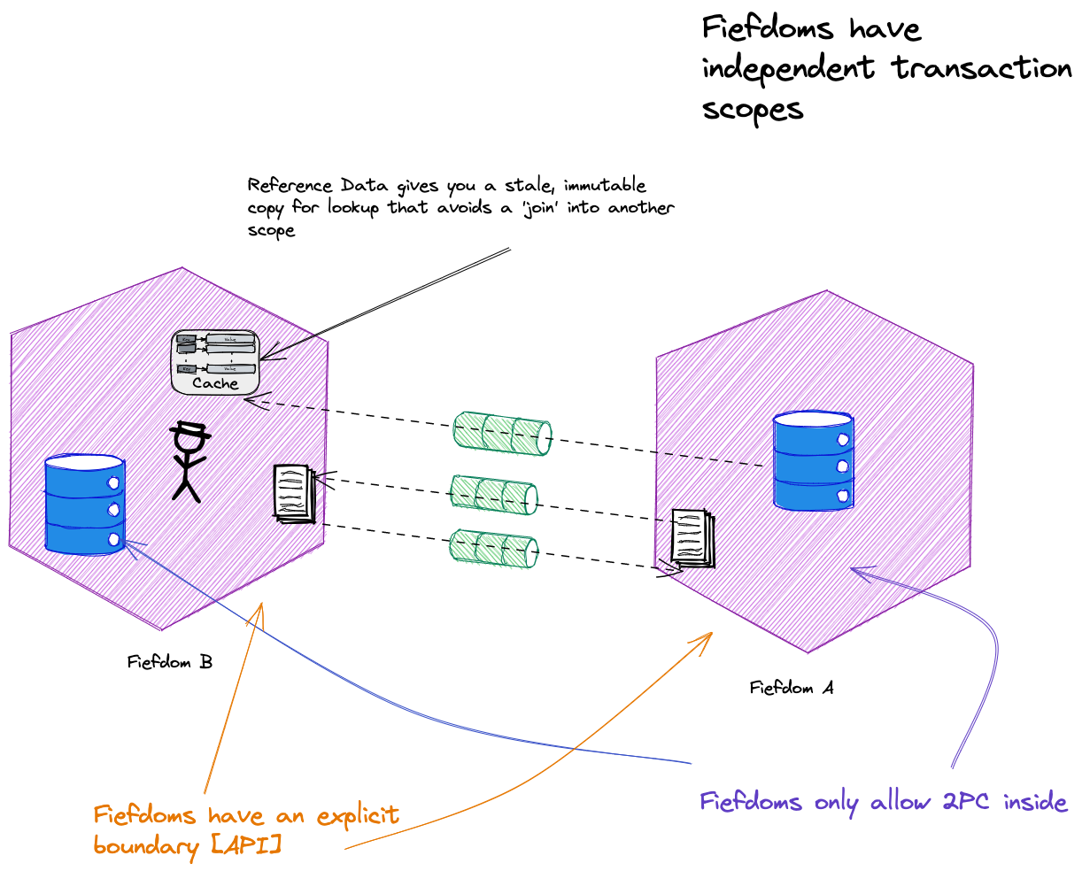
OUTSIDE DATA
INSIDE DATA
Notes:
Fiefdom – an autonomous co mponent boundary; it has encapsulated data; has an explicit boundary [may be an API]; no distributed transactions across fiefdoms, only “INSIDE its belly”
[A microservice is one type of fiefdom, but turtles all the way down, and a phone client is also a fiefdom (it can be offline)]
Is a fiefdom a microservice - turn it around, a microservice is a fiefdom, but so is an app running on a phone, or in a browser.

Slide 10
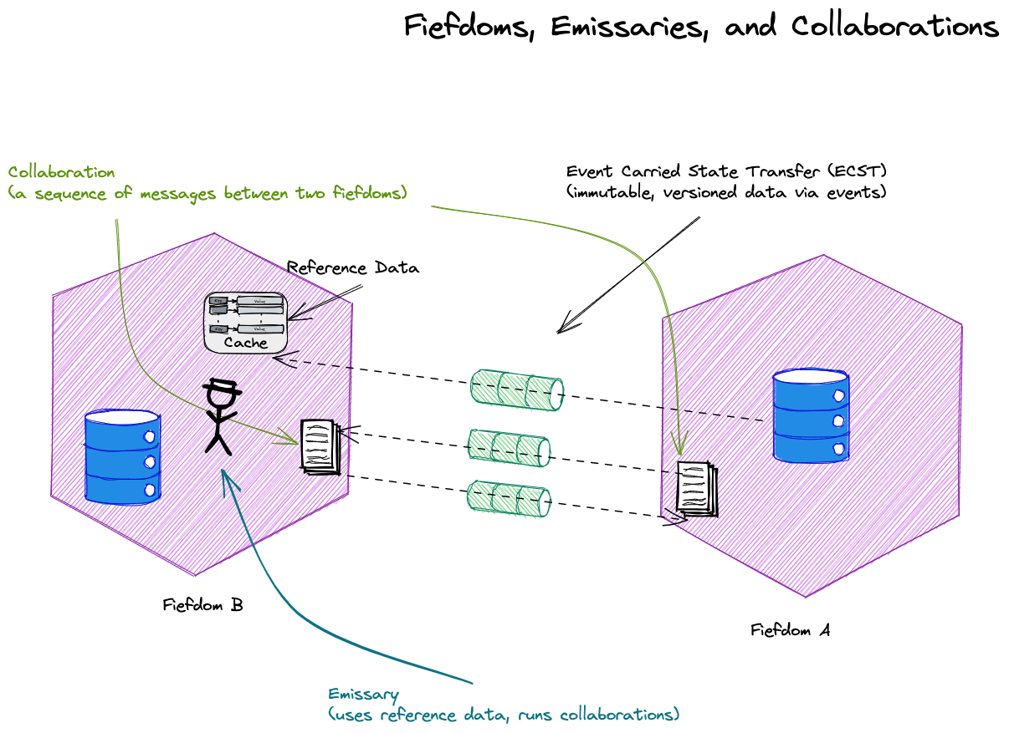
Notes:
Collaboration – “a set of messages into and out of a fiefdom for a single long running business operation” A dialogue
Emissaries – helps you engage with a fiefdom’s API; does not have INSIDE access; uses reference data, may hold user state. [UIs and SDKs are examples of emissaries ]
Reference Data – data published OUTSIDE of a fiefdom (such as by ECST) A monologue

Slide 11
Agenda
T:15
Fiefdoms: Autonomous Components
Collaborations: Work Across Fiefdoms
Future and Past: If Not Now, When?
Emissaries: Interacting with Fiefdoms
Messaging: Conversations Between Fiefdoms, Outbox and Inbox
Data: Resources, Activities, Reference, Requests
Brighter Example

Slide 12
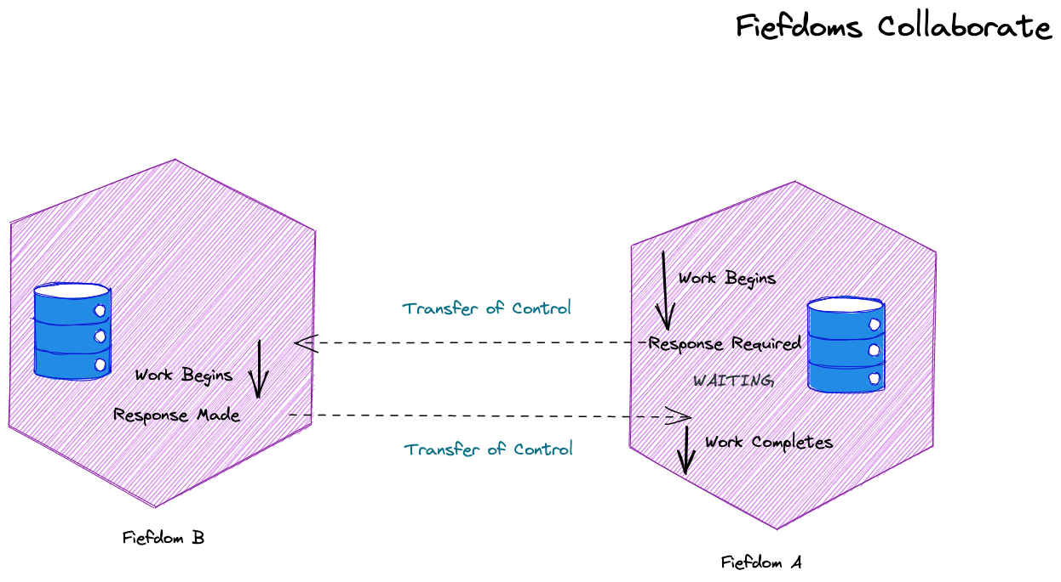
Fiefdoms have different responsibilities, but sometimes a fiefdom must request a service from another fiefdom. This can imply a fiefdom must transfer control.
Because we transfer control we think of this as a conversation or a dialog – a collaboration.

Slide 13
There is uncertainty here. We do not know how the other fiefdom will react. It might fail, cancel, or timeout. We need a way to manage that uncertainty.
“In a system that cannot count on distributed transactions, the management of uncertainty must be implemented in the business logic.” – Pat Helland

Slide 14
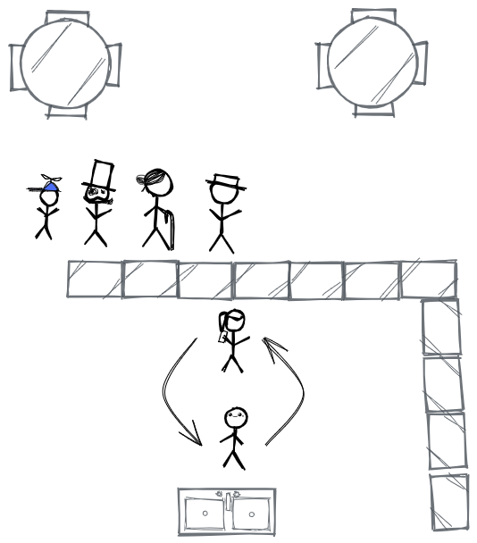
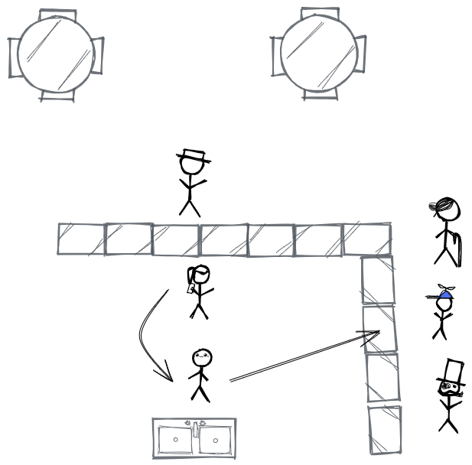
Starbucks Doesn’t Use Two Phase Commit.
We lose fewer customers as the constraint is now how fast we can put orders through the till.
The queue can only be serviced as fast as the barista can work.
The cup (with a name) is queued for the barista. The cup contains the details of the order.
Customers instead queue for their finished coffee, correlated by name.
The till operator takes the order, and passes it to the barista and waits for the coffee.
The till operator takes the order, and passes it to the barista. They serve the next customer.
Starbucks Does Not Use Two Phase Commit - Hohpe
Notes:
Starbucks uses messaging instead of

Slide 15
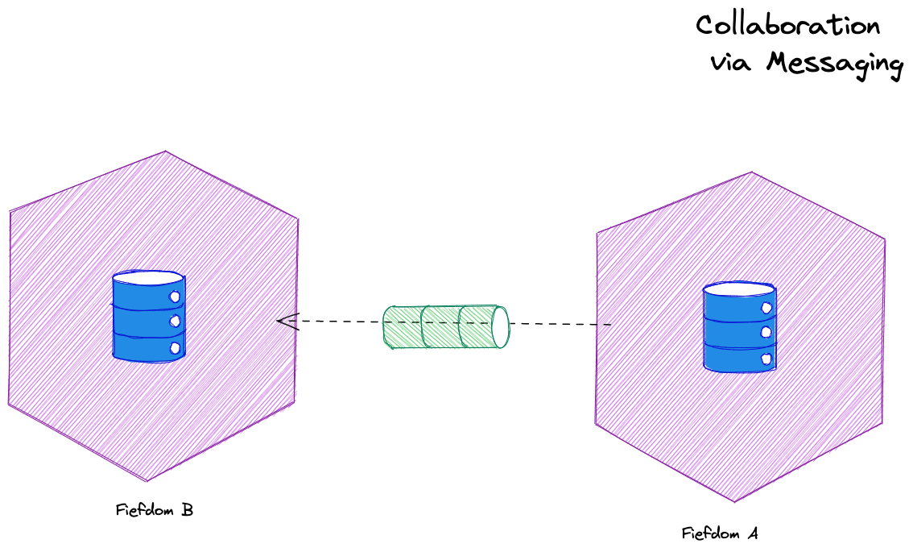
We do not use synchronous communication between fiefdoms – which implies holding open a transaction for a response – to update multiple entities. We use messaging.
Notes:
Because we cannot have a transaction spanning two entities we do not use synchronous communication – which implies holding open a transaction for a response – to update multiple entities
“If you can’t update the data across two entities in the same transaction, you need a mechanism to update the data in different transactions. The connection between the entities is via a message.”
Method calls are typically synchronous with respect to the calling thread. They are also synchronous with respect to the calling object’s transaction. While the called object may or may not be atomically coupled with the calling object, the typical method call does not
atomically record the intent to invoke a message and guarantee the at-least-once invocation of the called message. Some systems wrap message-sending into a method call and I consider those to be messages, not methods.

Slide 16
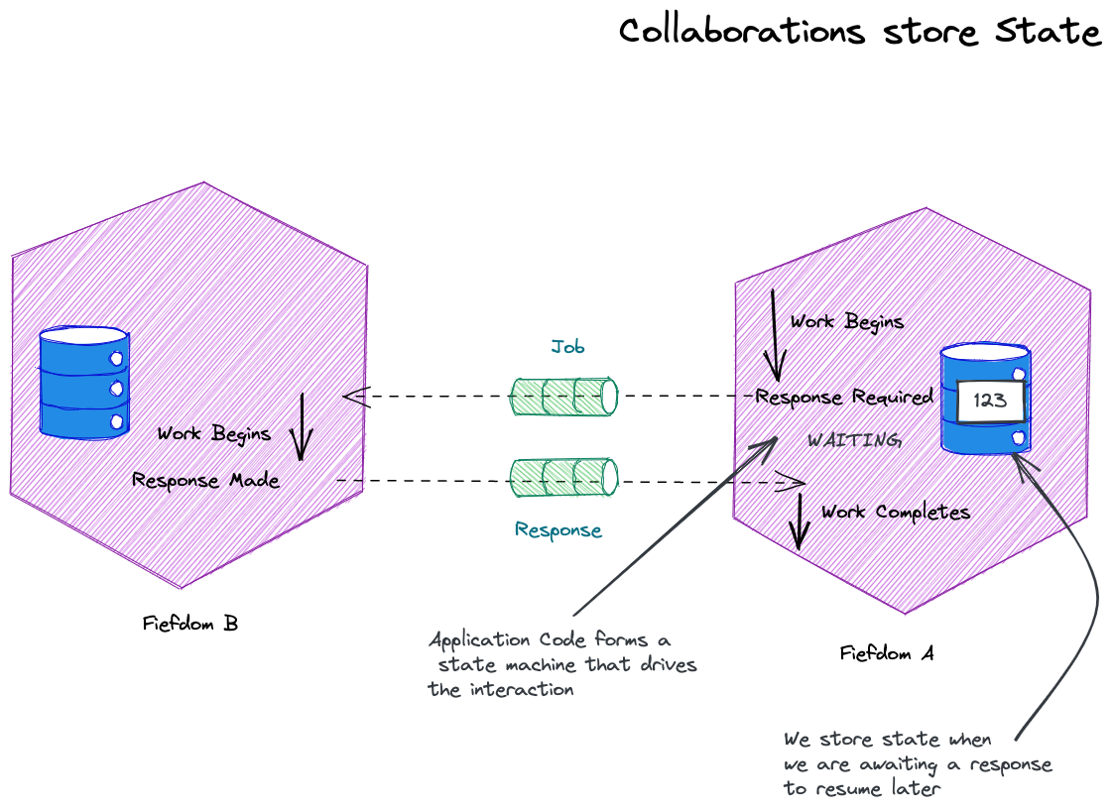
An activity is the code we execute (in response to a request, timer pop etc).
Activities are state machines to track an incoming collaboration and its sequence of messages.
Resilience provided by an activity may be a timeout forcing a step to be retried or abandoned, not simple recovery of state
An activity manages retries of operations
The activity may store state that allows us to resume an activity in the event of failure.

Slide 17
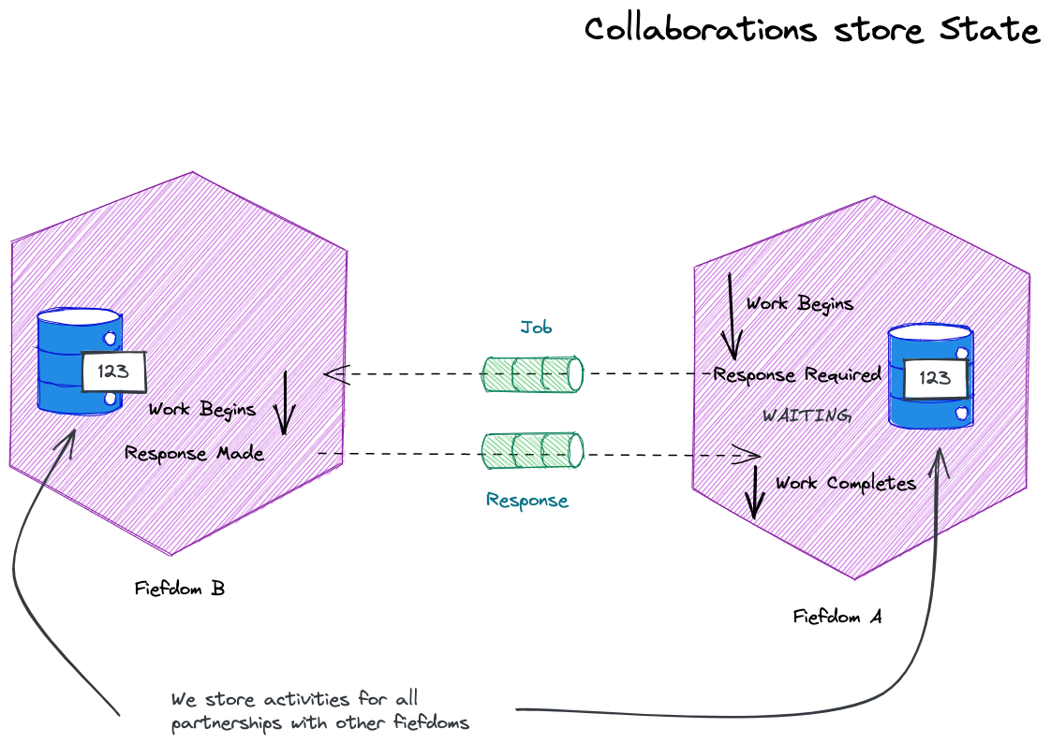
Each party has a record of the conversation – it keeps in the activity the record of the messages it sent and received.

Slide 18
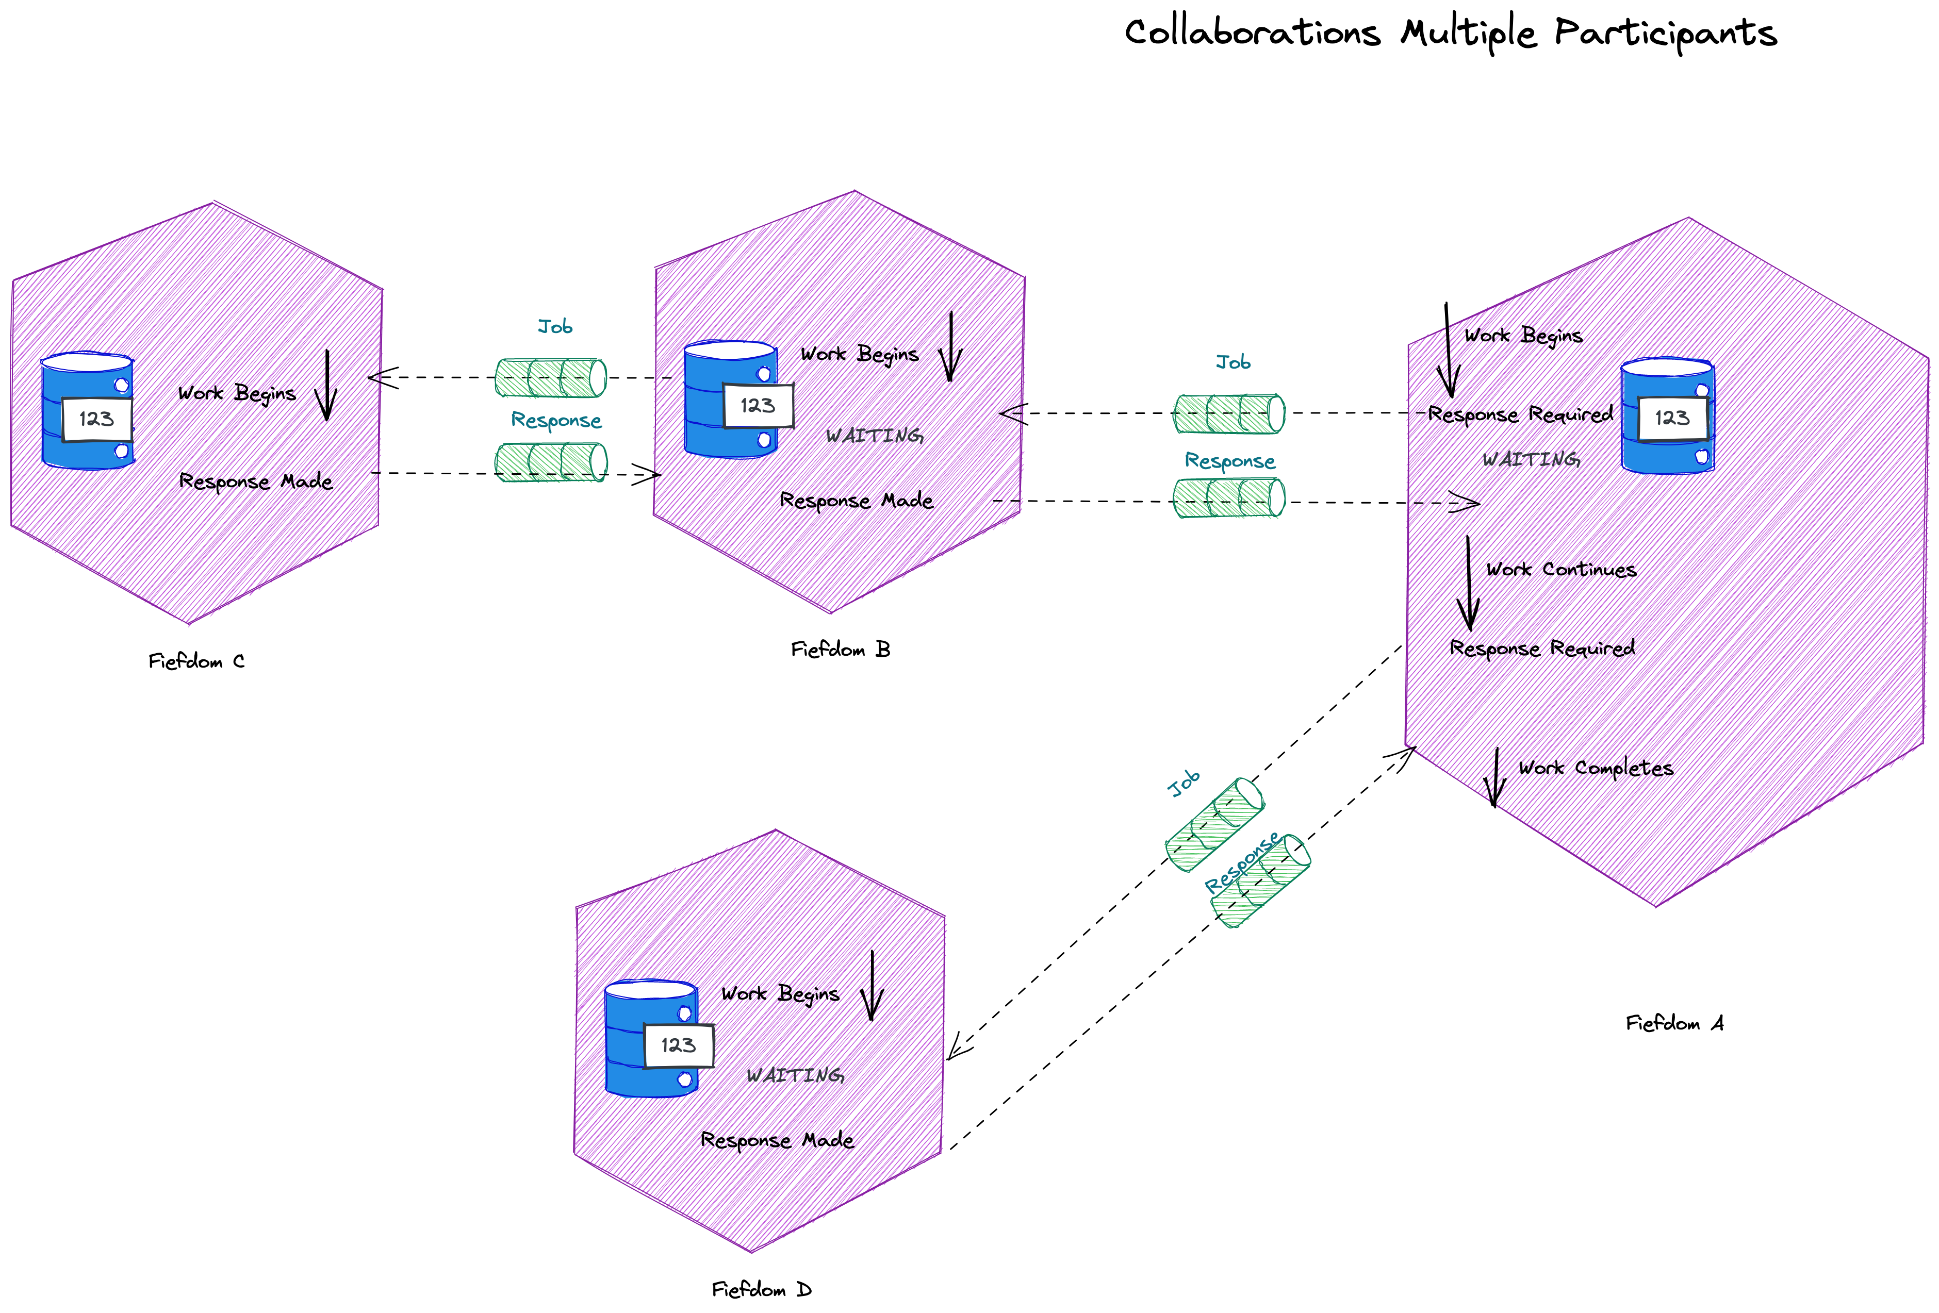
Some activities may create new collaborations to talk across other boundaries. Each activity is a long-running state machine supporting the flow of messages across one or more collaborations.

Slide 19
An activity needs to know which request a response was for; it does this via a correlation id: this is a response to that job.
The correlation id is typically added as a header on the message
Because a correlation is one interaction pair of many, we also need a conversation id.
Sometimes a natural id, such as an order id, provides the conversation id

Slide 20
A collaboration represents at least one request-reply with more than one partner.
A collaboration is the workflow, across all its participants. The conversation id is the identity of the collaboration.

Slide 21
An activity provides orchestration. It controls a steps in a workflow. It controls the fiefdom’s interaction with a partner.
Other fiefdoms we partner with, run their own activities to control their part of the work. This might include calling other fiefdoms. These sets of activities - a collaboration - are choreography as they are not centrally coordinated.
We often suggest choreography or orchestration – but in this collaborations orchestration is an activity, choreography is a collaboration.
The activity runs within the fiefdom, not external to it in a process manager. Smart endpoints and dumb pipes.

Slide 22
An activity allows us to preserve causality. If the first step must succeed before we run the second step, application code operates as a state machine to ensures that happens
Without a state machine controlling the order, Fiefdom D could execute its work, without Fiefdom B succeeding

Slide 23
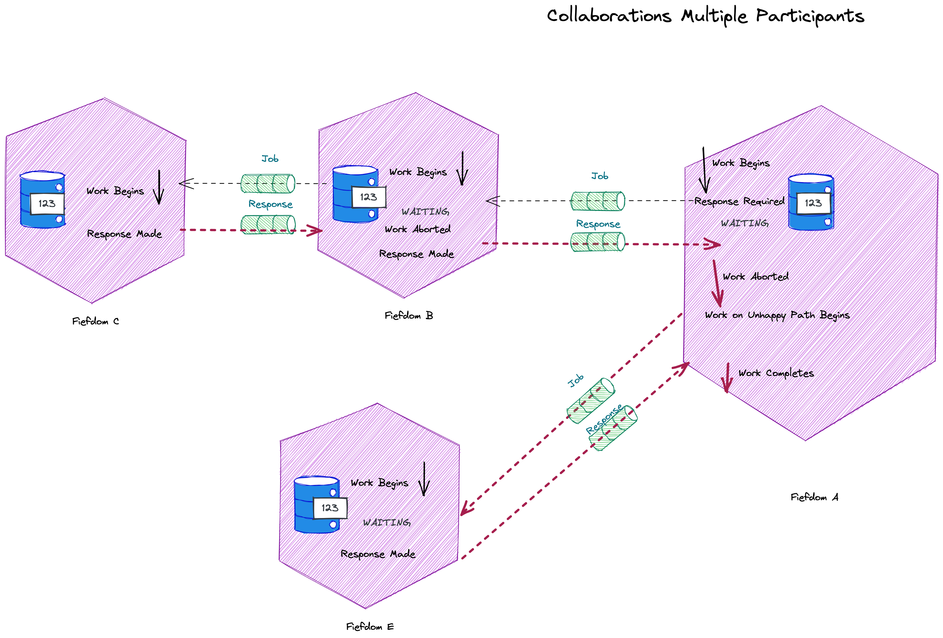
An activity also lets us manage unhappy paths – they are just the states we move into given a unhappy result from an exchange of messages

Slide 24
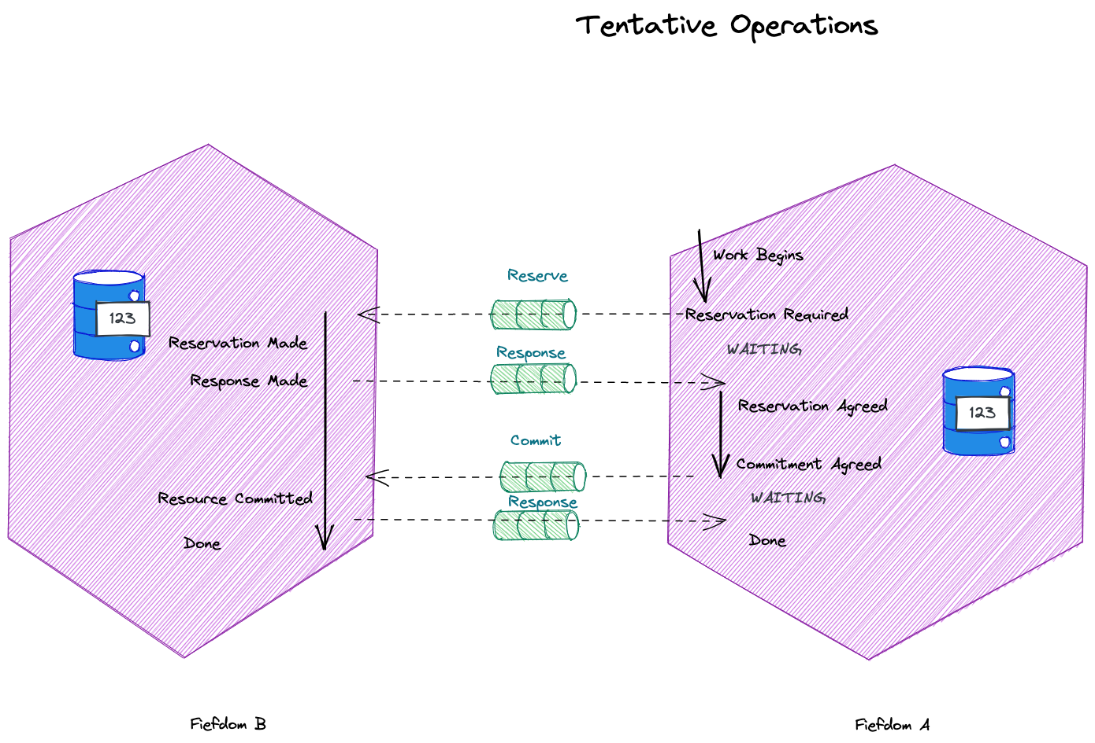
A tentative operation is one where we don’t know if participants should commit yet, we need them to be ready to do so.

Slide 25
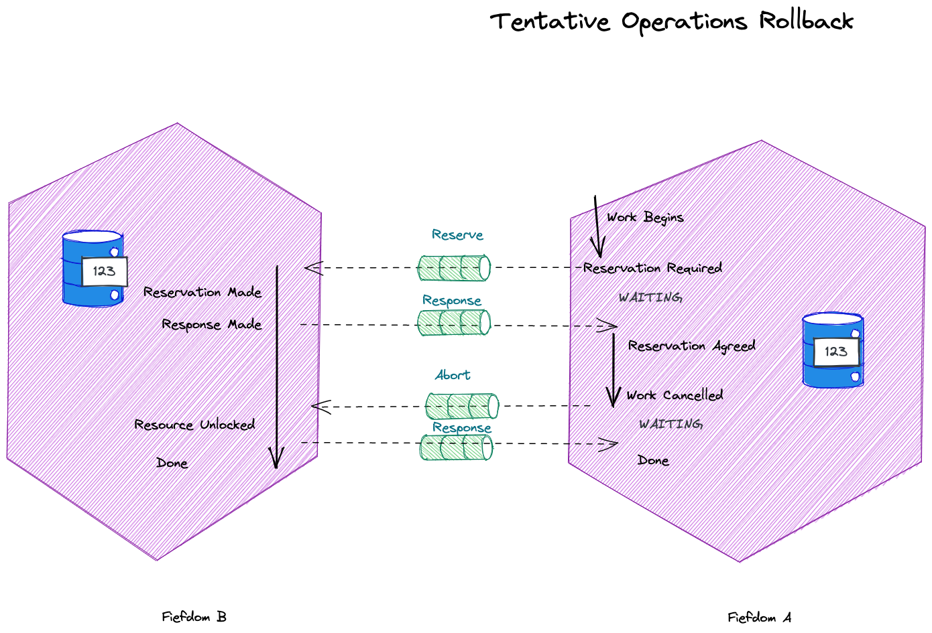
A tentative operation can rollback to unlock resources reserved in another fiefdom.

Slide 26
Of course this looks a lot like 2PC or a saga – but it’s a collaboration so there is no coordinator or process manager. Smart endpoints, dumb pipes.

Slide 27
Agenda
T:30
Fiefdoms: Autonomous Components
Collaborations: Work Across Fiefdoms
Future and Past: If Not Now, When?
Emissaries: Interacting with Fiefdoms
Messaging: Conversations Between Fiefdoms, Outbox and Inbox
Data: Resources, Activities, Reference, Requests
Brighter Example

Slide 28
Message Types
Messaging
Eventing
Has Intent
Provides Facts
Request An Answer (Query)
Transfer of Control
(Command)
Transfer of Value
Things you Report On
No Expectations
History
Part of a Workflow
Part of a Conversation
Context
Concerned with the Future
Concerned with the Past
After Clemens Vasters https://youtu.be/ITrlLErsqzY

Slide 29
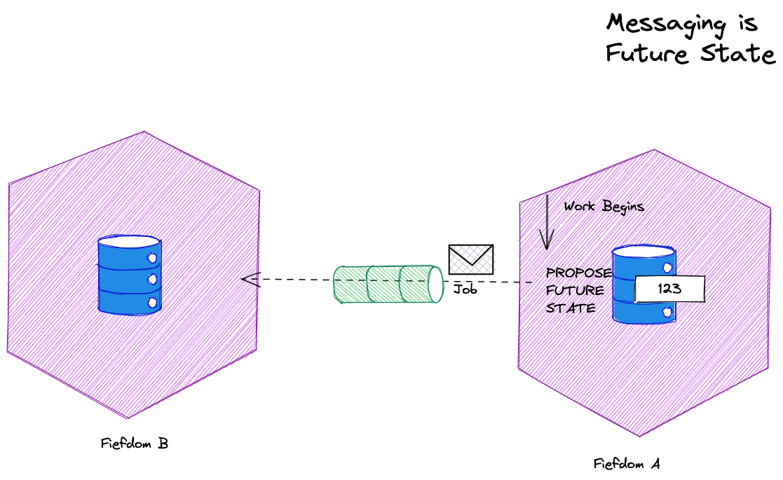
Messaging is a proposal about the future – a request to change something, a request for information

Slide 30
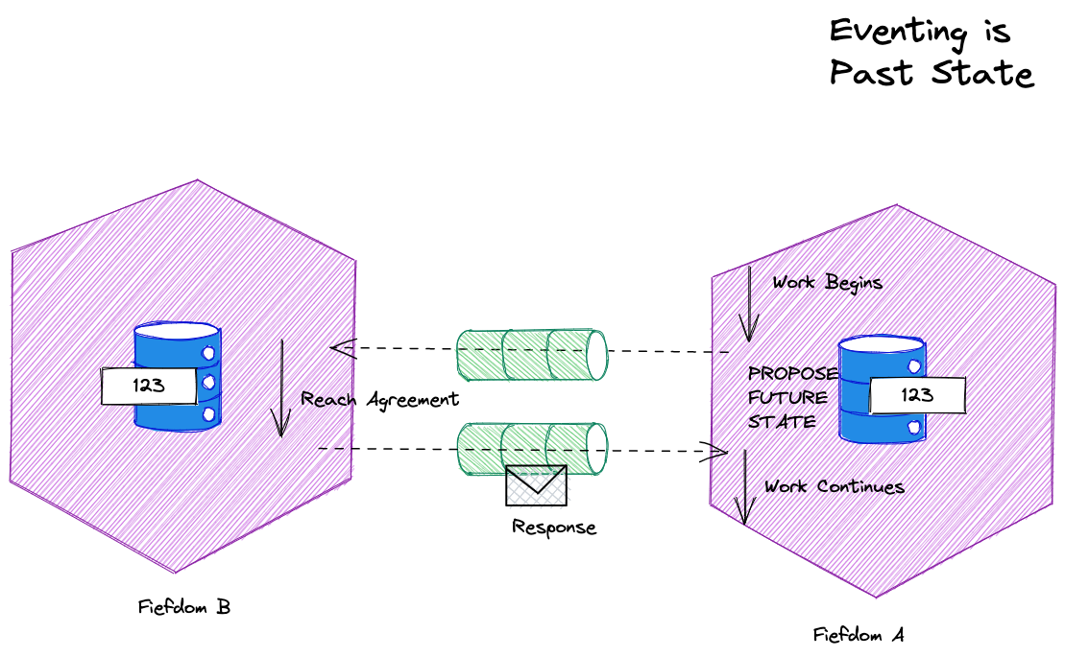
Eventing is facts about the past. It has already happened. It is immutable, stale, and should be versioned.

Slide 31
Event Types
Series
Discrete
PUSH
PULL
Context
Offset
Stateless
Handler
Stateful
Partition
Processor
Discrete
Continuous
Independent
Sequential
Immediately Actionable
Report Condition
Part of a Conversation
Part of a Monolog
After Clemens Vasters: https://skillsmatter.com/skillscasts/10191-keynote-events-data-points-jobs-and-commands-the-rise-of-messaging
See also: https://en.wikipedia.org/wiki/Discrete_time_and_continuous_time

Slide 32
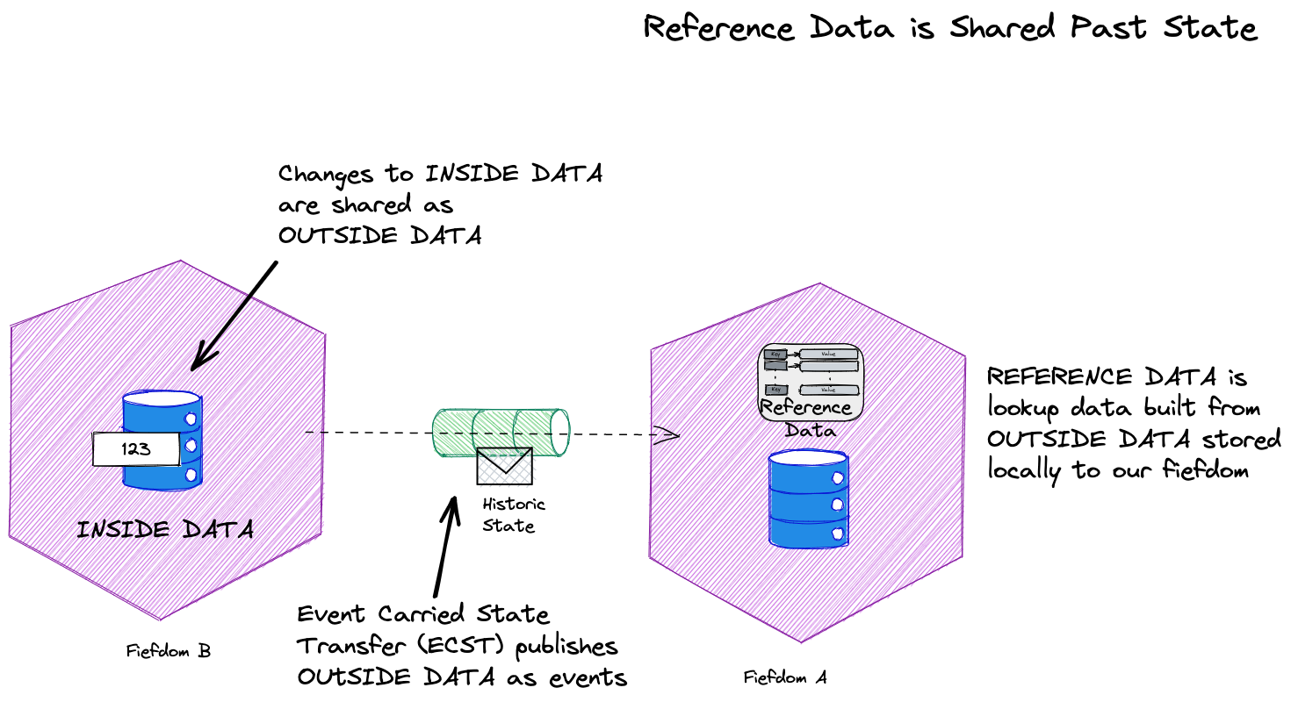
Our fiefdom wants information from another fiefdom, to do work, but we can’t query the database in another fiefdom and don’t want to expose a GET
Reference Data provides a lookup within the zone of our fiefdom, preventing the need for a query.
Reference Data is stale, so we need to keep pumping the changes to it.
Because we don’t listen to a response we think of this as a monolog

Slide 33
Agenda
T:35
Fiefdoms: Autonomous Components
Collaborations: Work Across Fiefdoms
Future and Past: If Not Now, When?
Emissaries: Interacting with Fiefdoms
Messaging: Conversations Between Fiefdoms, Outbox and Inbox
Data: Resources, Activities, Reference, Requests
Brighter Example

Slide 34
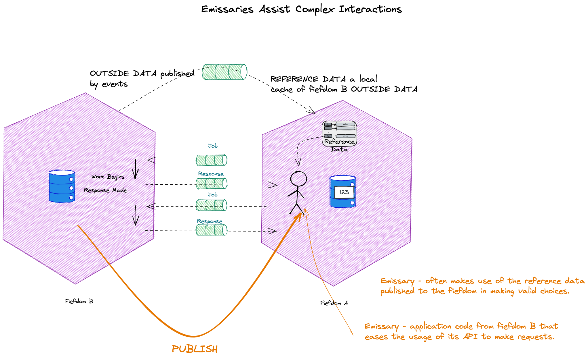
An simple example is that the fiefdom is a user agent or phone, and the emissary is UI code published so that the user can interact with the fiefdom. Reference data represents options e.g. eCommerce
A fiefdom does not trust its emissary
Equally this could be an SDK published by one microservice and used by another
We validate input, even if it comes from our own emissary

Slide 35
An emissary behaves as though it were offline.
- Uses Reference Data, does not query
- Builds up a collaboration
- Tracks per user state
- Sends ‘job’ to fiefdom at the end.

Slide 36
Agenda
T:40
Fiefdoms: Autonomous Components
Collaborations: Work Across Fiefdoms
Future and Past: If Not Now, When?
Emissaries: Interacting with Fiefdoms
Messaging: Conversations Between Fiefdoms, Outbox and Inbox
Data: Resources, Activities, Reference, Requests
Brighter Example

Slide 37
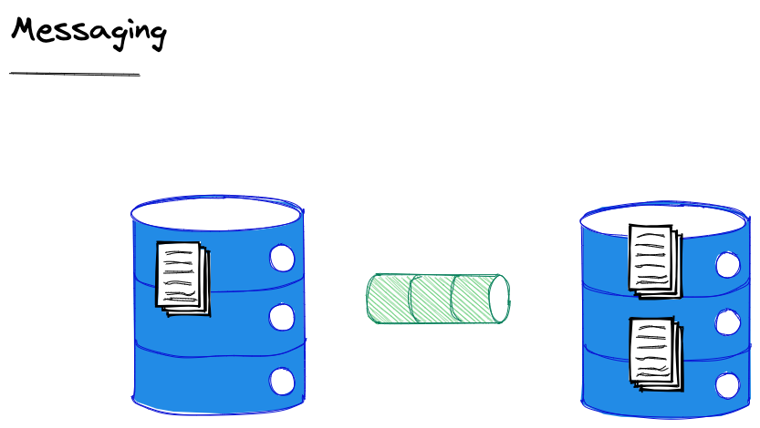
We do not use synchronous communication – which implies holding open a transaction for a response – to update multiple entities. We use messaging.
Notes:
Because we cannot have a transaction spanning two entities we do not use synchronous communication – which implies holding open a transaction for a response – to update multiple entities
“If you can’t update the data across two entities in the same transaction, you need a mechanism to update the data in different transactions. The connection between the entities is via a message.”
Method calls are typically synchronous with respect to the calling thread. They are also synchronous with respect to the calling object’s transaction. While the called object may or may not be atomically coupled with the calling object, the typical method call does not
atomically record the intent to invoke a message and guarantee the at-least-once invocation of the called message. Some systems wrap message-sending into a method call and I consider those to be messages, not methods.

Slide 38
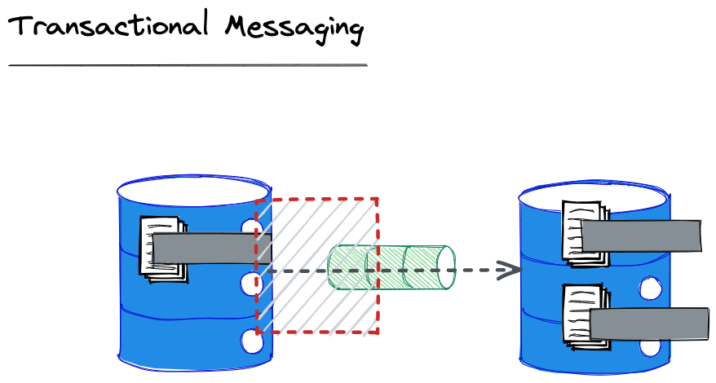
We must ensure that the message is enqueued using a transaction with the entity change, otherwise the other entity will become inconsistent because no message was sent!

Slide 39
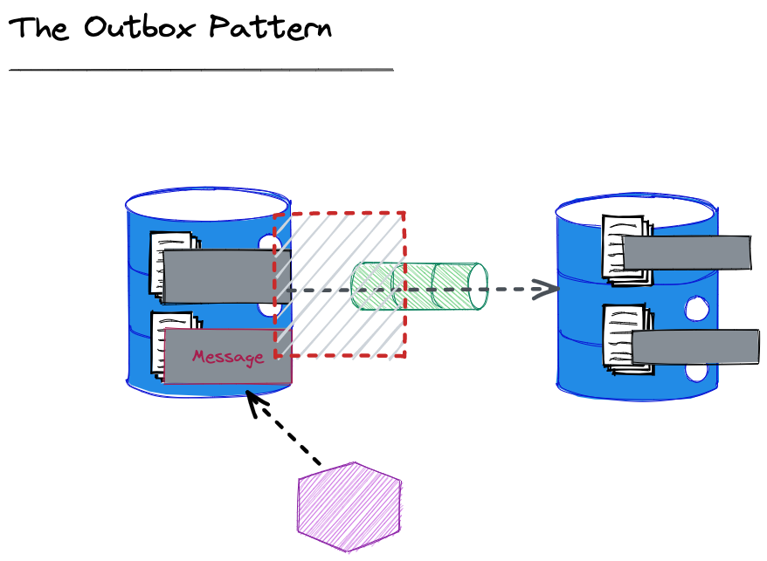
We can also send the message written immediately from the application to reduce latency (caused by the polling interval for the worker).
We are unable to create a transaction between Db and queue
We create an Outbox table and write the message we intend to send to that, in a transaction with the write with the changed/added entity
A worker looks for messages that have not been marked as sent, and sends them. It will retry until sent.
Notes:
This slide isn’t about Pat’s paper, it’s a pattern to solve the conundrum of enqueuing the message in the same transaction as the entity posed by Pat, in the absence of a transaction across queue and database.

Slide 40
We can’t know if our failure to receive an ack from the broker that a message was sent means it actually was not sent.
For this reason although we offer guaranteed delivery it is at least once, because we must resend until we get an ack.

Slide 41
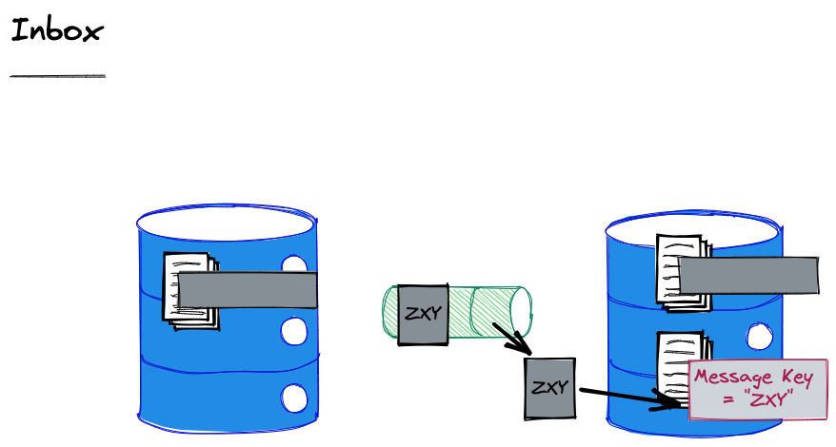
To ensure that we do not process a message twice, we record the ids of the messages that we have seen and discard duplicates.
Notes:
Defining Idempotence of Substantive Behavior
The processing of a message is idempotent if a subsequent execution of the processing does not perform a substantive change to the entity. This is an amorphous d efinition which leaves open to the application the specification of what is and what is not substantive. If a message does not change the invoked entity but only reads information, its processing is idempotent. We consider this to be true even if a log record describing the read is written. The log record is not substantive to the behaviour of the entity. The definition of what is and what is not substantive is application specific.

Slide 42
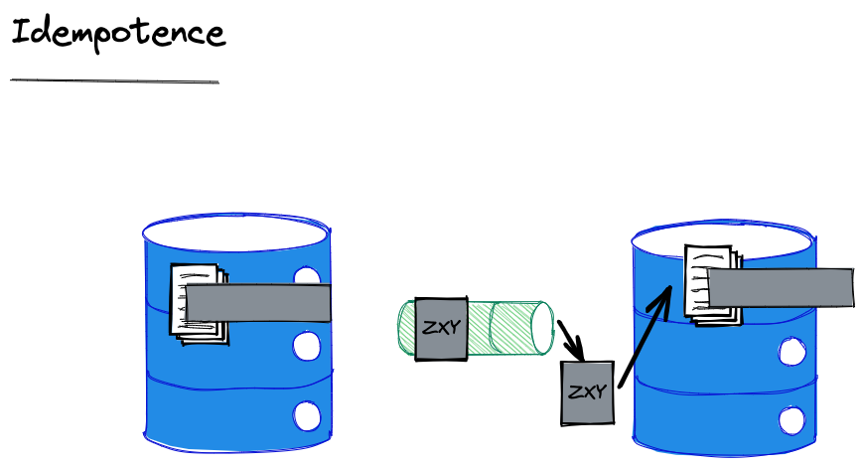
The alternative to an Inbox is idempotence. We say that a message is idempotent if reprocessing it does not carry substantive side effects.
Notes:
Substantive here is for the application to determine and is deliberately loose. But for example, writing a log would not be considered substantive in most cases.

Slide 43
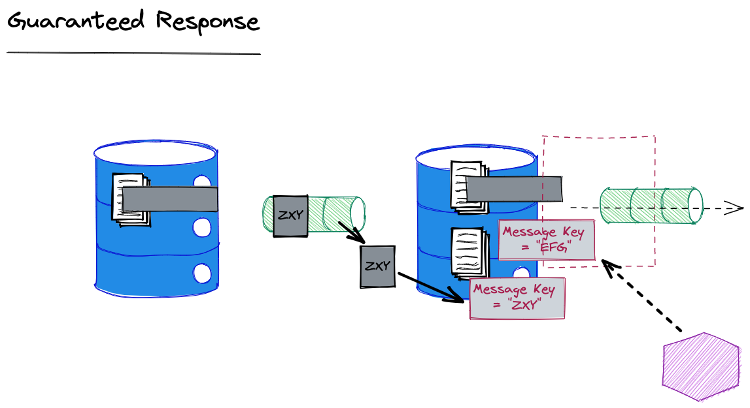
It is possible that we received a duplicate because our response was not received. We may choose to resend our response in that case.
We want to resend our original response.
By deleting the published timestamp in our outbox, we can get our outbox sweeper to resend it.
Notes:
In addition to remembering that a message has been processed, if a reply is required, the same reply must be returned. After all, we don’t know if the original sender has received the reply or not.

Slide 44
What happens if our Db does not support a transaction between our outbox and entity?
Notes:
Pat Helland says: “transactional enqueuing of messages is de rigueur” (actually referring to a message sent without the corresponding entity update at the source. But despite sneaking in this idea that there is a transaction around sending a message (and dequeuing a message – don’t ack until you have actioned) he does not describe how to achieve it within the limitations of “no 2PC”
If we have an activity that uses the same key as the entity we would get co-location and a transaction would be on the same cluster.
Note that if we use something like DynamoDb transactions don’t optimise for being on the same cluster node, they are just 2PC, so practically this is not necessarily a priority for most implementers

Slide 45
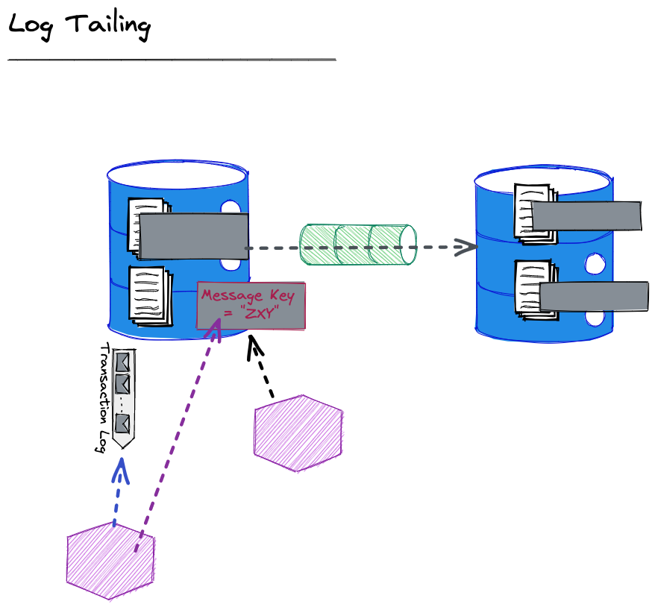
A Transaction Log is a stream representing the writes to the entity store
Then as before a worker looks for unsent messages in the outbox and sends them
A worker listens to the Transaction Log, and creates needed events, writing them to the outbox.

Slide 46
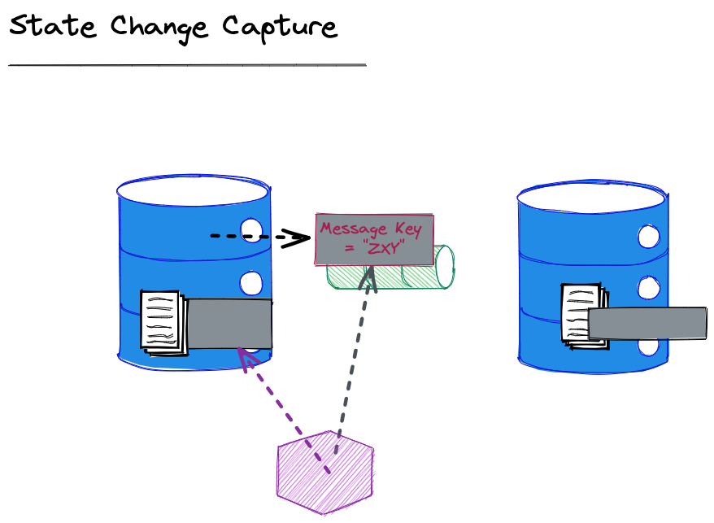
We raise the message before any corresponding write to an entity
On reading the message – we write to the origin entity

Slide 47
Agenda
T:50
Fiefdoms: Autonomous Components
Collaborations: Work Across Fiefdoms
Future and Past: If Not Now, When?
Emissaries: Interacting with Fiefdoms
Messaging: Conversations Between Fiefdoms, Outbox and Inbox
Data: Resources, Activities, Reference, Requests
Brighter Example

Slide 48
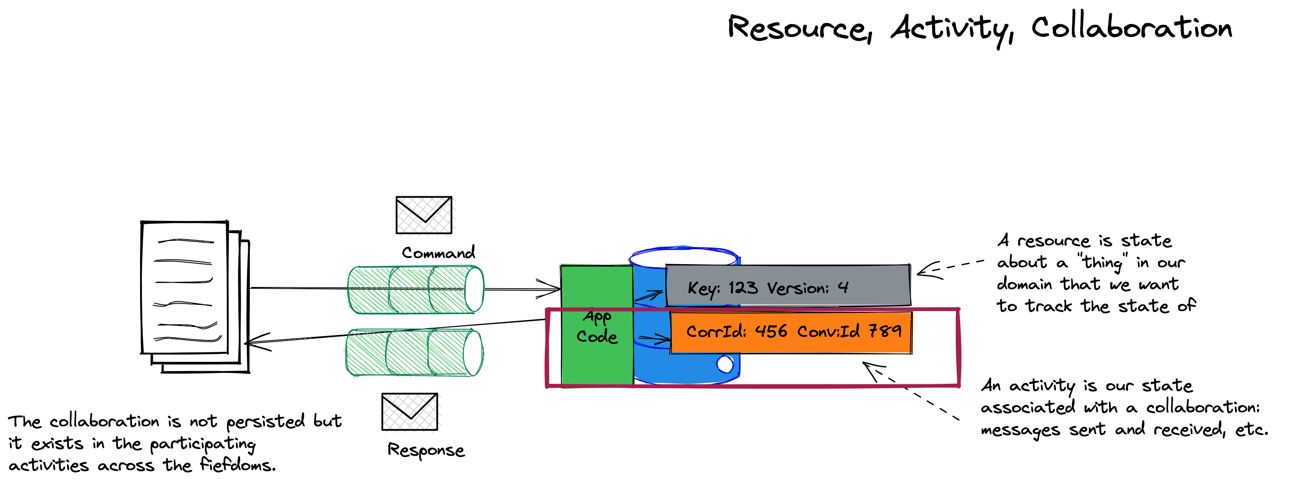
This is application code so there are varied ways to implement this:
- Separate activity and resource
- Aggregate
- Workflow Engine
- …

Slide 49
Agenda
T:50
Fiefdoms: Autonomous Components
Collaborations: Work Across Fiefdoms
Future and Past: If Not Now, When?
Emissaries: Interacting with Fiefdoms
Messaging: Conversations Between Fiefdoms, Outbox and Inbox
Data: Resources, Activities, Reference, Requests
Brighter Example

Slide 50
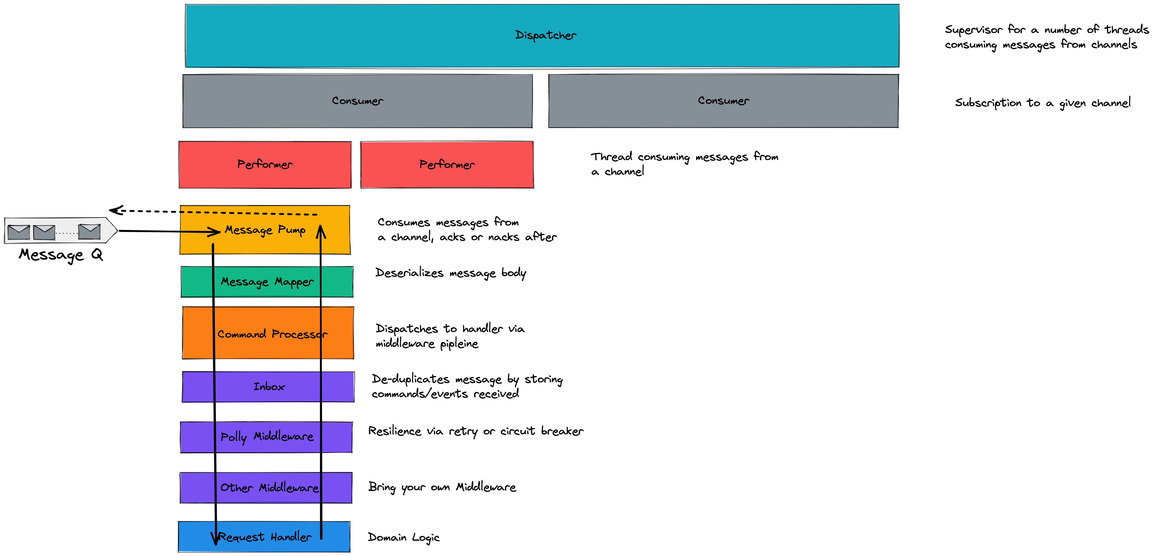
Brighter has a:
Message Pump that reads from a queue and dispatches to a middleware pipeline
Inbox in it’s pipeline
Handler that runs domain code

Slide 51
This is an activity:
Stores the history of incoming messages
Executes code in response to a message
Updates resources
Raises new messages
Can store current state

Slide 52
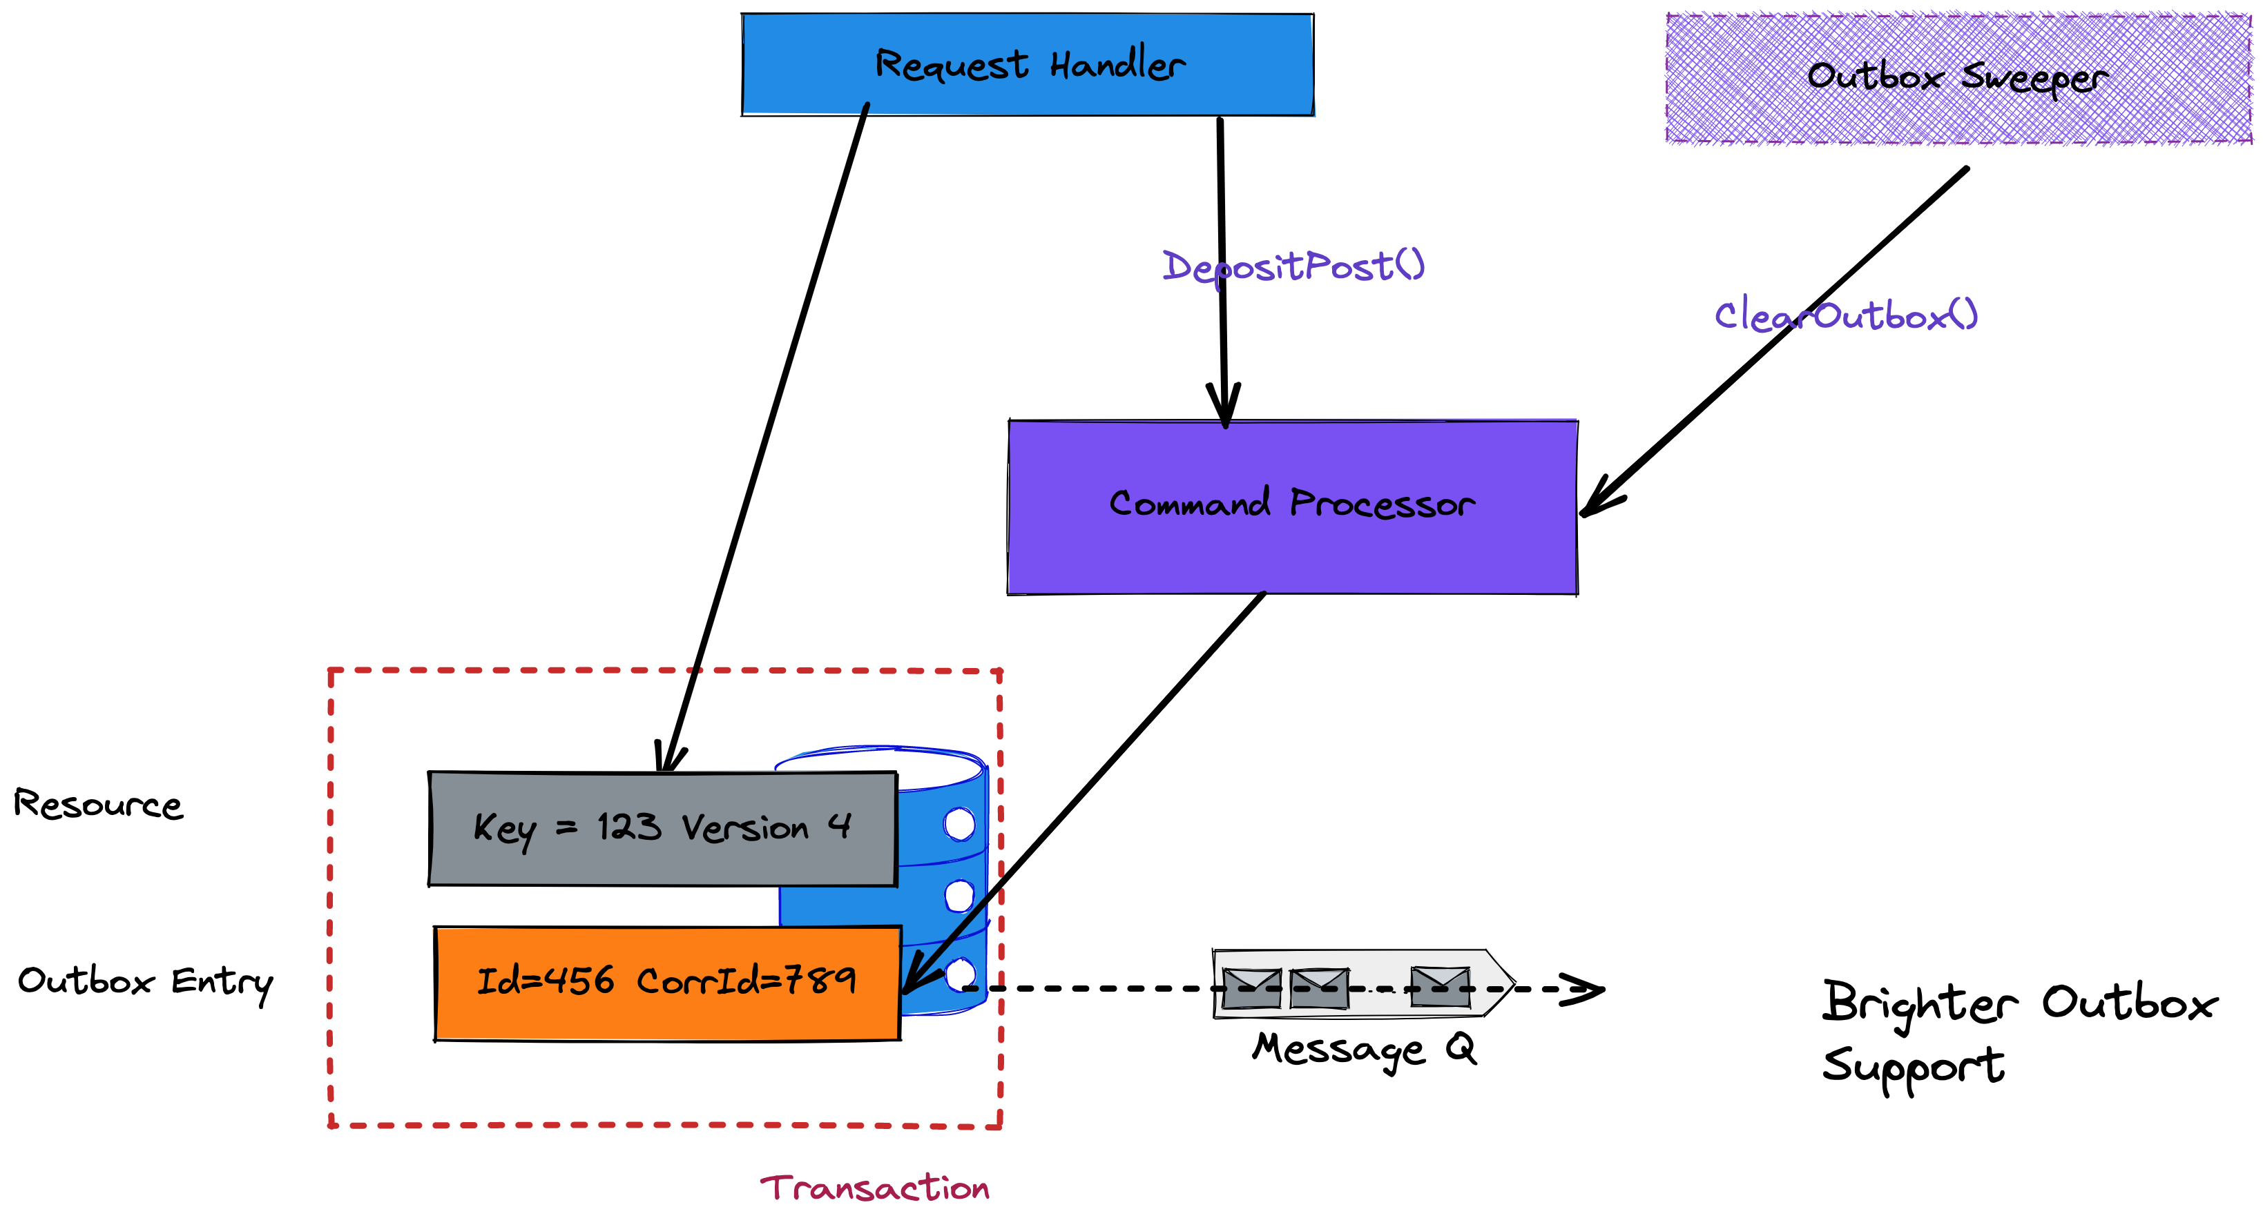
Within a transaction we:
Write a resource
Write a message to the Outbox
A separate thread
Flushes any unsent messages to the queue
Marks them as sent once broker confirms

Slide 53
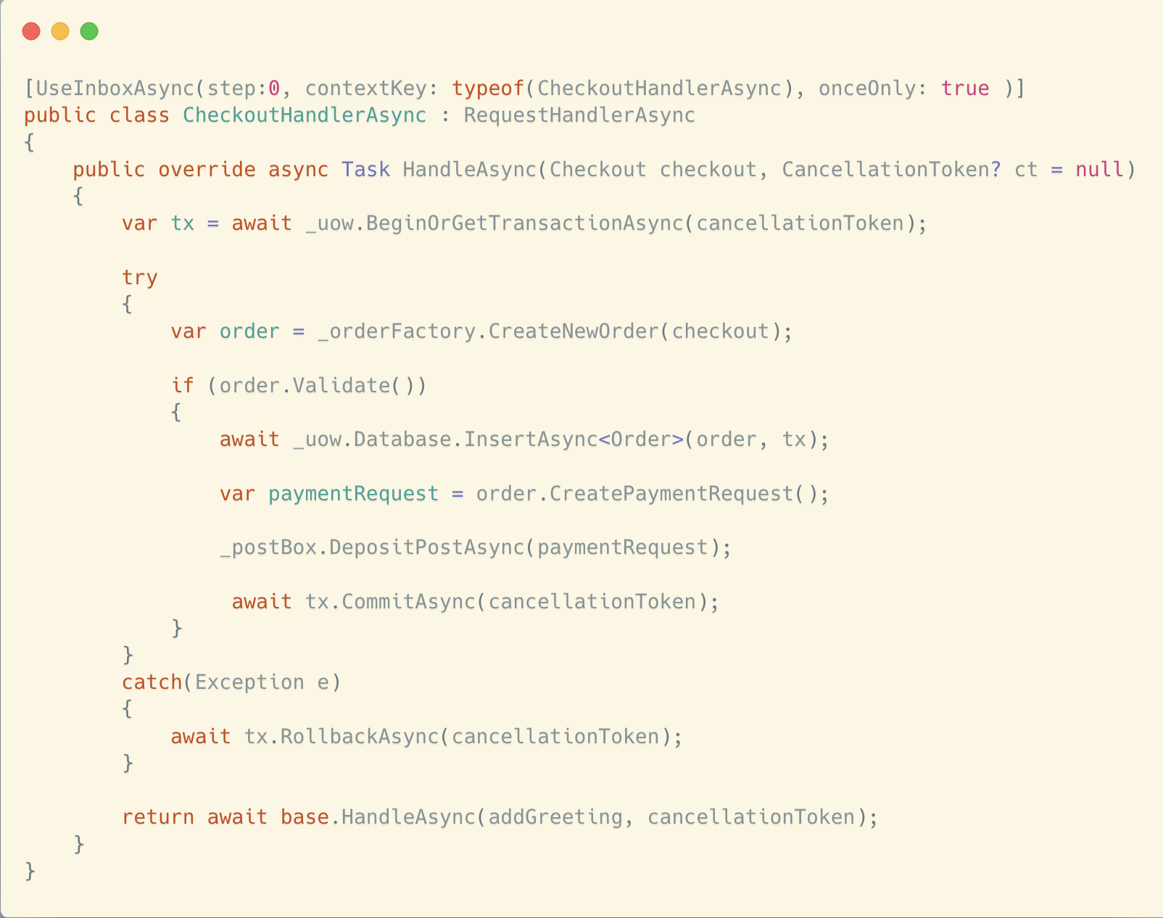

Slide 54
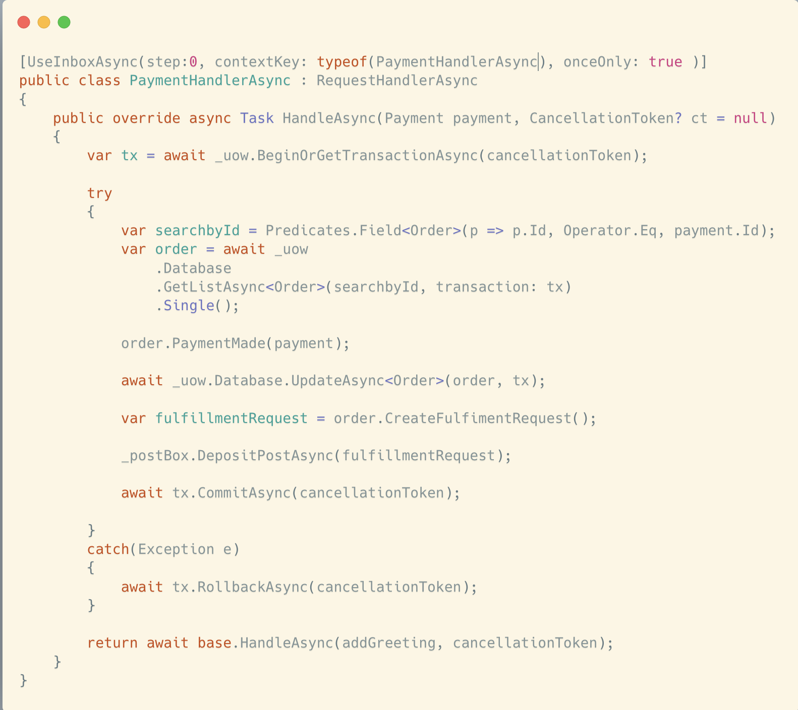

Slide 55
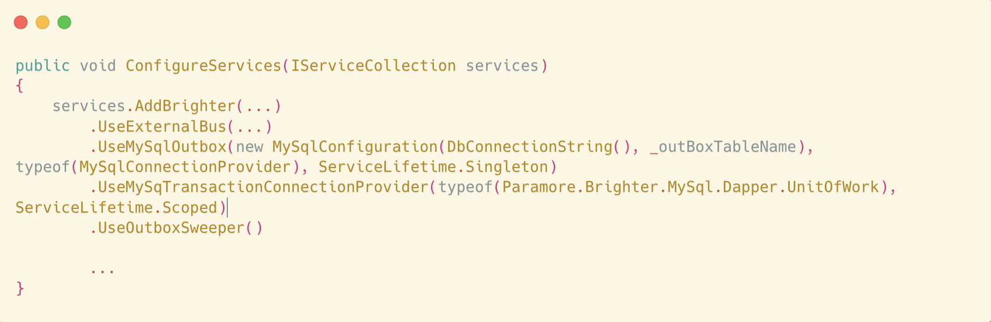

Slide 56
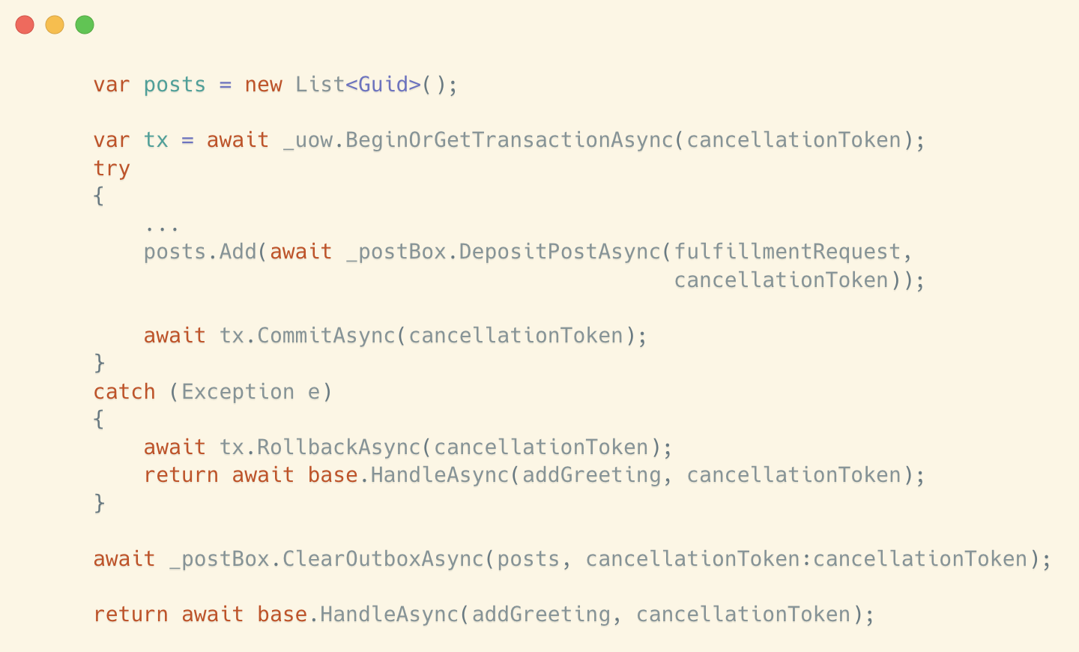

Slide 57
No need to use a coordinator/saga
No need to use 2PC

Slide 59
Agenda
Fiefdoms: Autonomous Components
Collaborations: Work Across Fiefdoms
Future and Past: If Not Now, When?
Emissaries: Interacting with Fiefdoms
Messaging: Conversations Between Fiefdoms, Outbox and Inbox
Data: Resources, Activities, Reference, Requests
Brighter Example

Slide 60

END

